Slide 1

This practical class needs to be divided into groups, please make a group of 1~3 people.
https://www.shutterstock.com/zh-Hant/image-vector/icon-people-vector-727689157

Slide 2
Developing Spark Projects with Jupyter on Docker
Presenter: Youteng Liang (梁有騰)

Slide 3
Outline
Spark Introduction
Docker Introduction
Docker Installation
Spark Installation with Docker
Practice: Gender Detector with ML
Commit Docker Image
Exercise

Slide 4
Outline
Spark Introduction
Docker Introduction
Docker Installation
Spark Installation with Docker
Practice: Gender Detector with ML
Commit Docker Image
Exercise

Slide 5

Spark
Apache Spark is an open-source analytics engine for big-scale data processing.
Spark uses in-memory caching, and optimized query execution for fast analytics and queries.
Spark supports Scala, Java, R, and Python in the original version, and .Net, Julia, and more languages with 3rd party support.
https://en.wikipedia.org/wiki/Apache_Spark

Slide 6
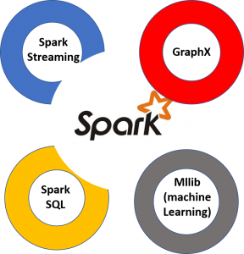
Why Spark?
In-memory caching and processing
Spark streaming for real-time analytics
GraphX for graph processing
Spark Mllib for machine learning
Spark SQL for queries
https://aws.amazon.com/tw/big-data/what-is-spark/

Slide 7
Outline
Spark Introduction
Docker Introduction
Docker Installation
Spark Installation with Docker
Practice: Gender Detector with ML
Commit Docker Image
Exercise

Slide 8
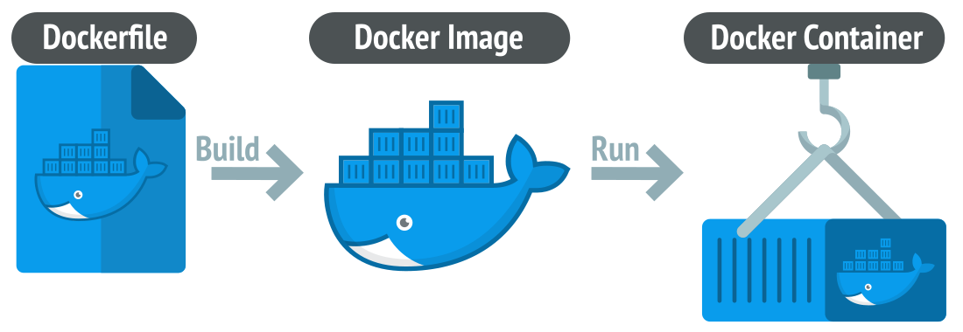
Docker
Docker is an open-source platform, which is for fast developing, shipping, and executing applications.
A docker image usually contains lots of containers, each of them having an independent environment.
Docker images can be pushed to Docker Hub or other repositories; Docker can be pulled and then executed on other computers.
https://linuxiac.com/what-is-docker-container/

Slide 9
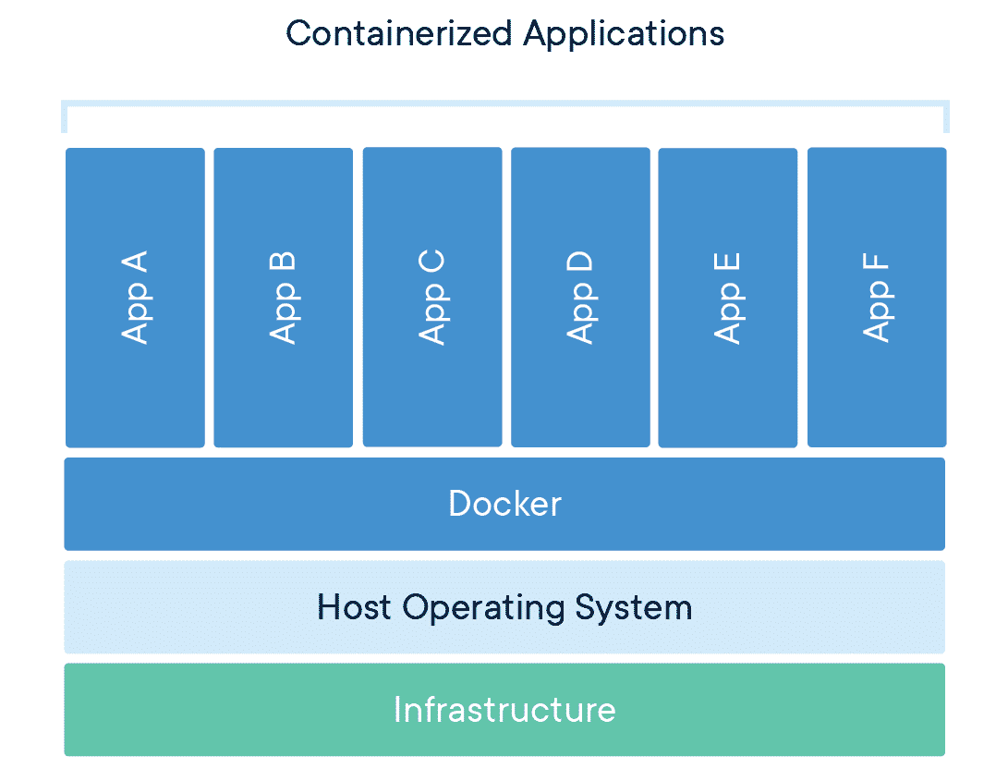
Docker Container
https://www.docker.com/resources/what-container/

Slide 10
Outline
Spark Introduction
Docker Introduction
Docker Installation
Spark Installation with Docker
Practice: Gender Detector with ML
Commit Docker Image
Exercise

Slide 11
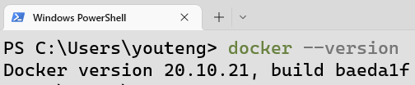
Docker Installation for Windows
Download Docker Desktop and install it.
Execute wsl_update_x64.msi to upgraded WSL to WSL2.
Reboot your computer.
Launch Docker Desktop.
Type the command in your terminal to check if installed.

Slide 12
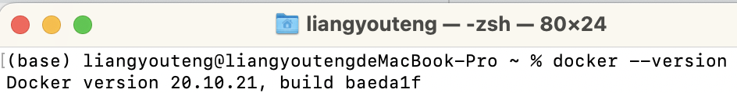
Docker Installation for macOS
Download Docker Desktop and install it.
Reboot your computer.
Launch Docker Desktop.
Type the command in your terminal to check if installed.

Slide 13
Outline
Spark Introduction
Docker Introduction
Docker Installation
Spark Installation with Docker
Practice: Gender Detector with ML
Commit Docker Image
Exercise

Slide 14
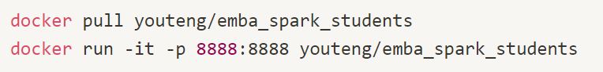
Spark Installation with Docker
Using pull to pull a pre-build docker image from Dock Hub.
Using run to run a docker image, and the port will be set as 8888:8888 with parameter –p.

Slide 15
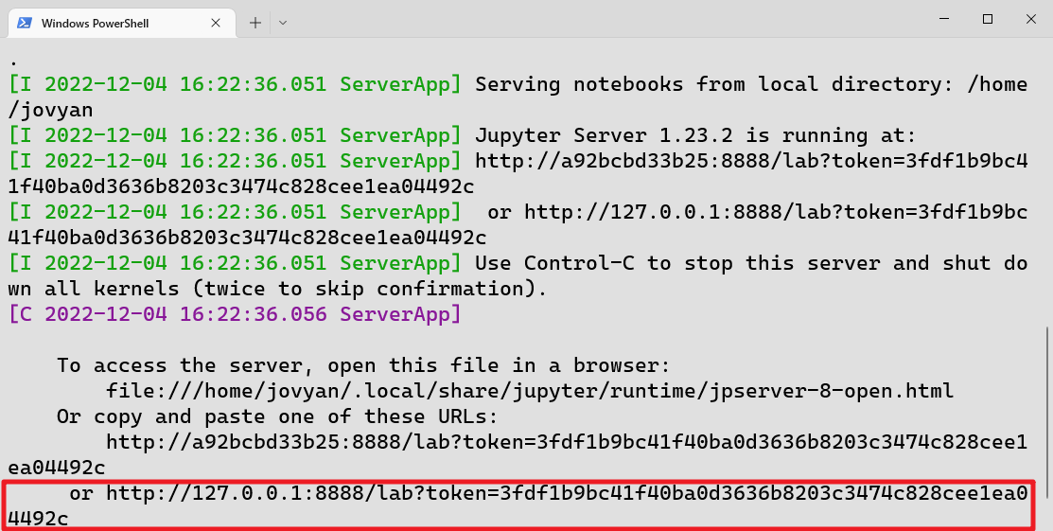
Jupyter Lab
After you run the command, a unique URL to the local jupyter lab is created.
Click the link to open Jupyter lab.

Slide 16
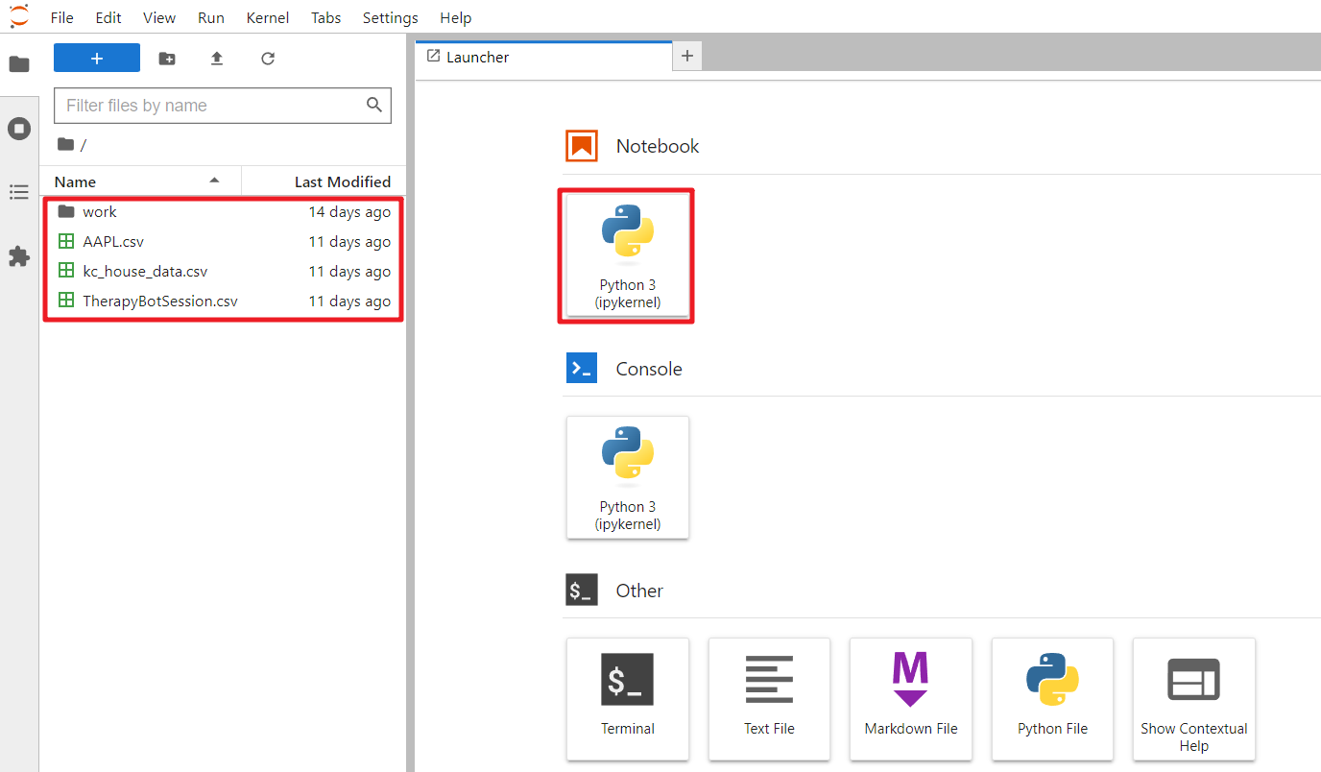
Jupyter Lab (Cont’d)

Slide 17
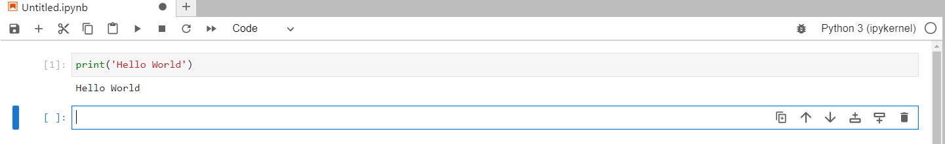
Jupyter Notebook
Code cell
Notebook name
Execute button
Python Code
Output

Slide 18

Google Colab
Before we start coding, we should know how to use Colab.
Colab allows you can write & run python code online.
Colab provides free GPU resources for Machine learning (ML) and model training.
https://clay-atlas.com/blog/2019/09/29/colab-chinese-tutorial/

Slide 19
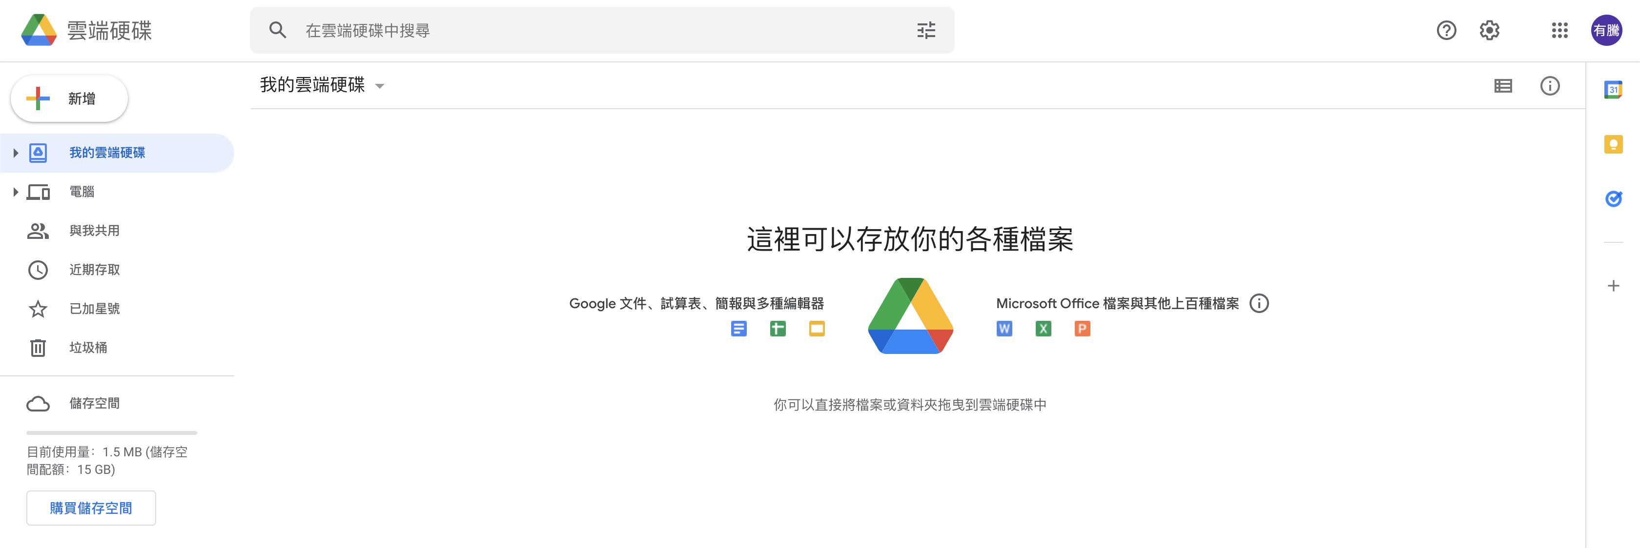
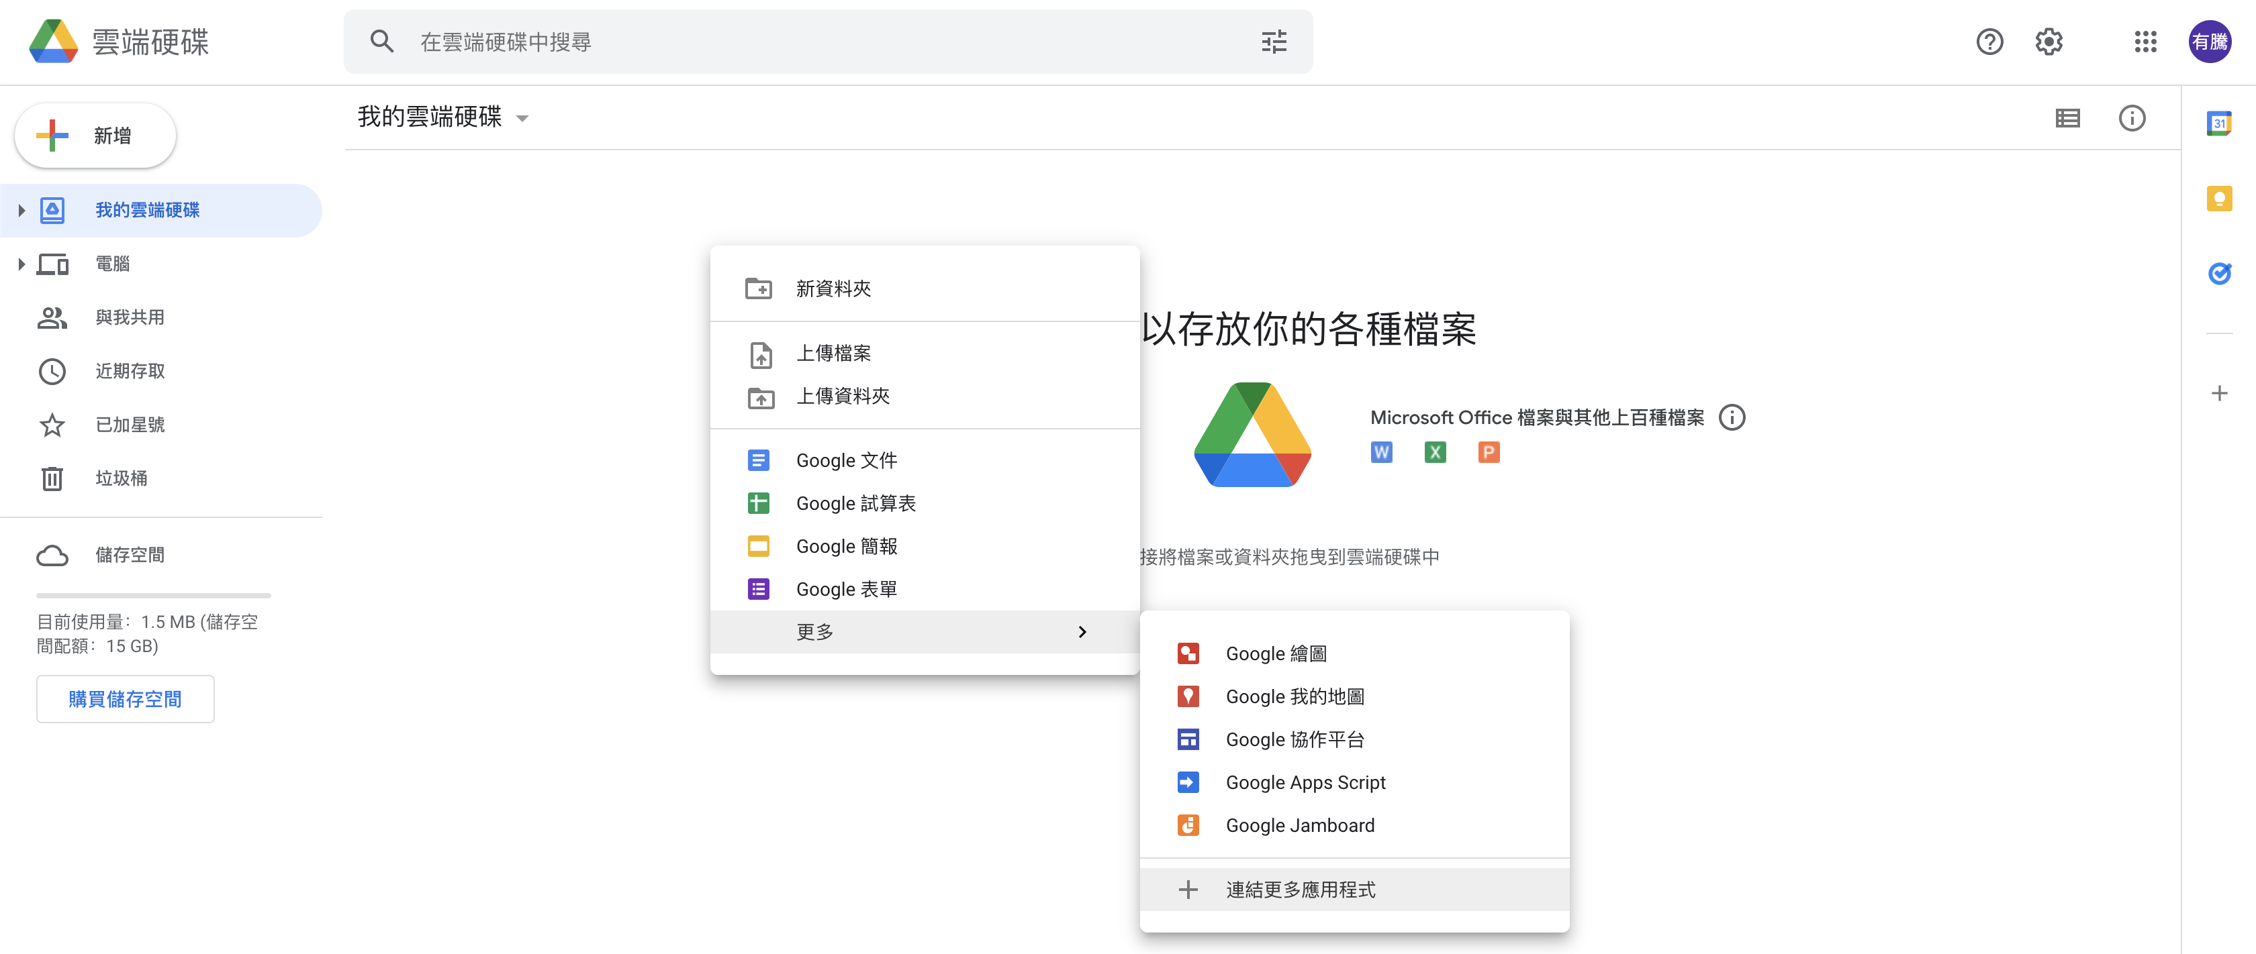
Connect Colab into Google Drive
We should connect Colab into google drive before we use it.
Right Click
Notes:
The steps are as the following figure.

Slide 20
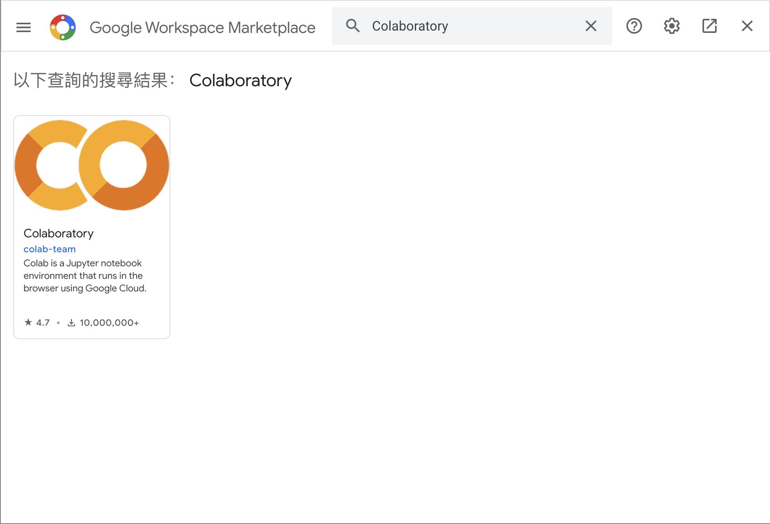
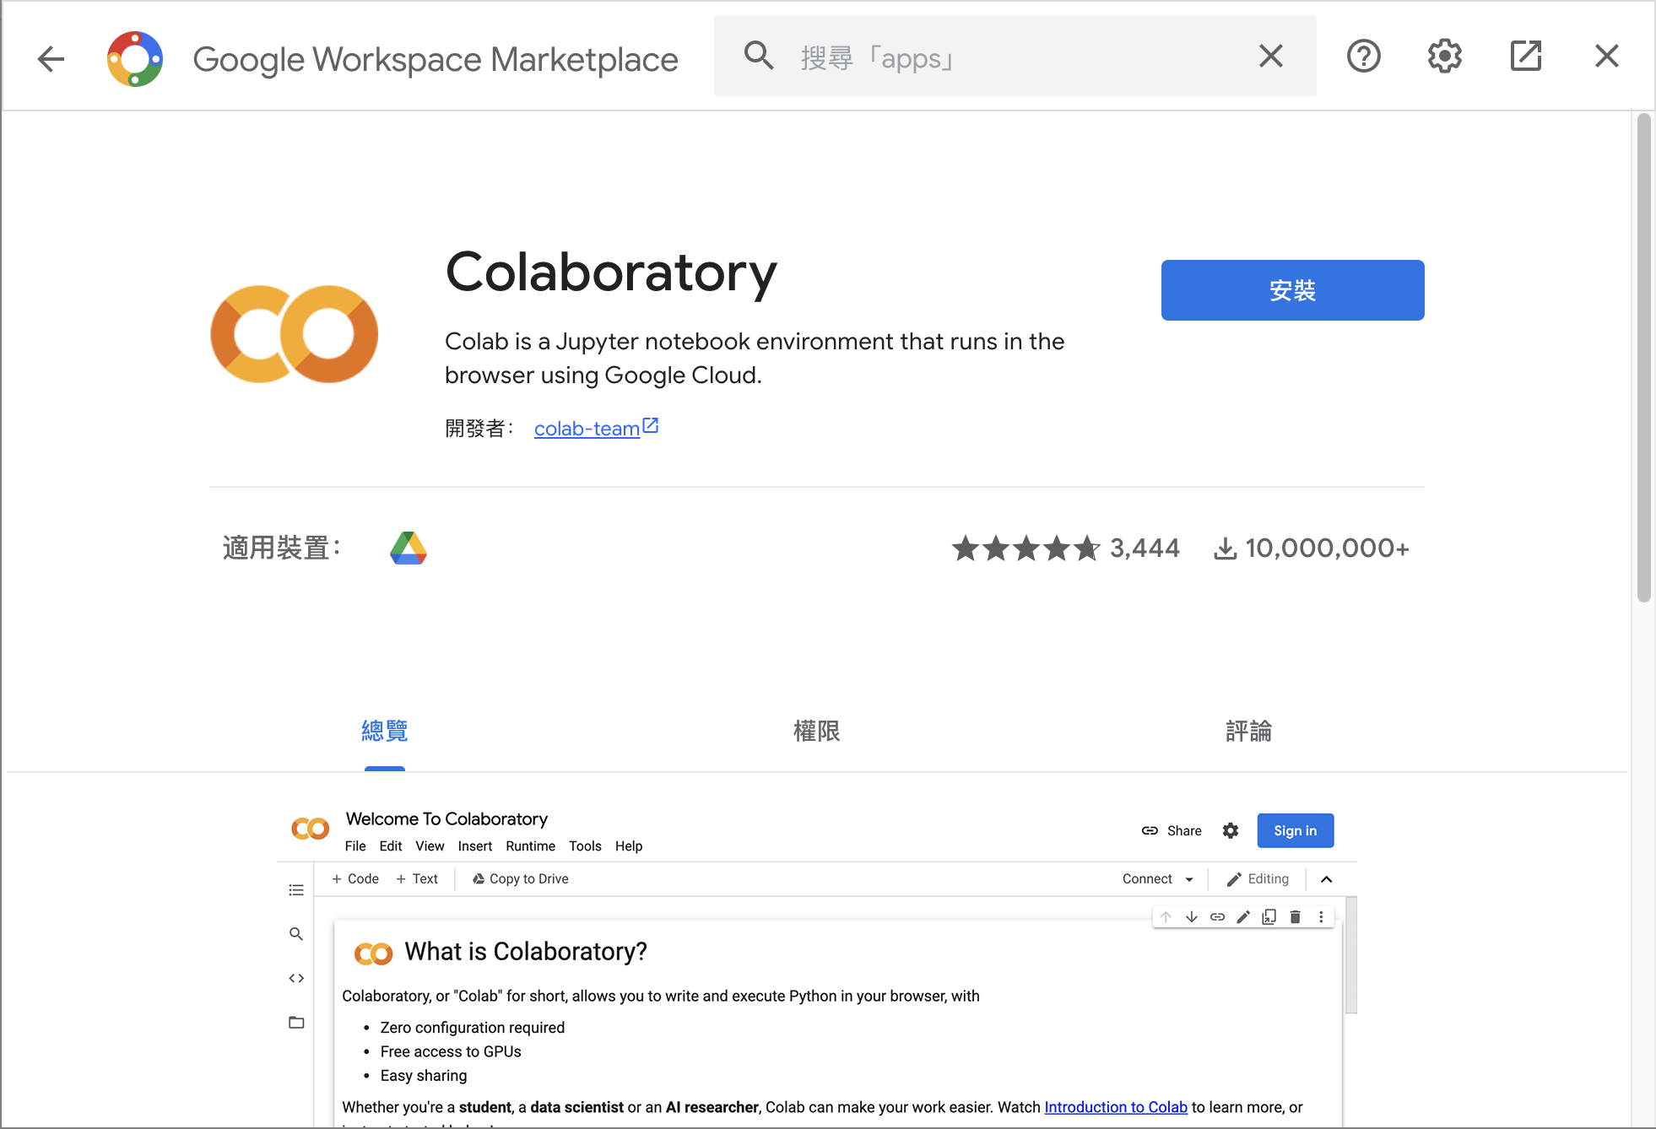
Connect Colab into Google Drive (Cont’d )
Search Colab and install it.

Slide 21
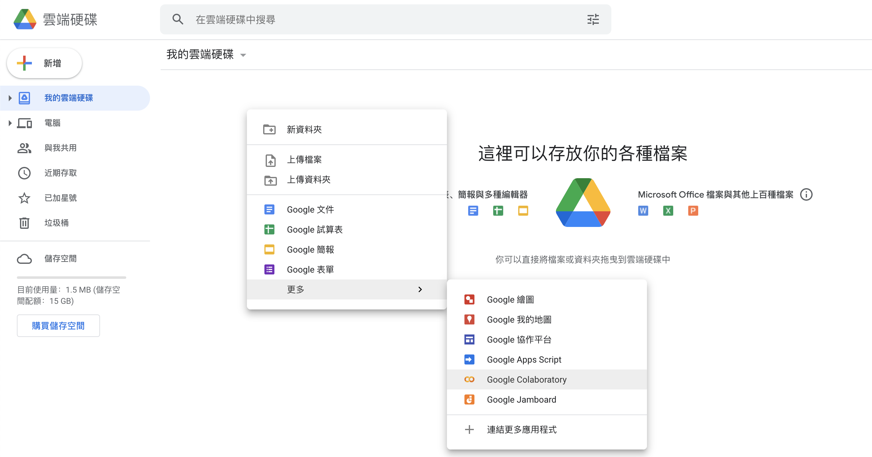
Connect Colab into Google Drive (Cont’d )
After installation, you can create a new Colab notebook.
Notes:
The steps are as the following figure.

Slide 22
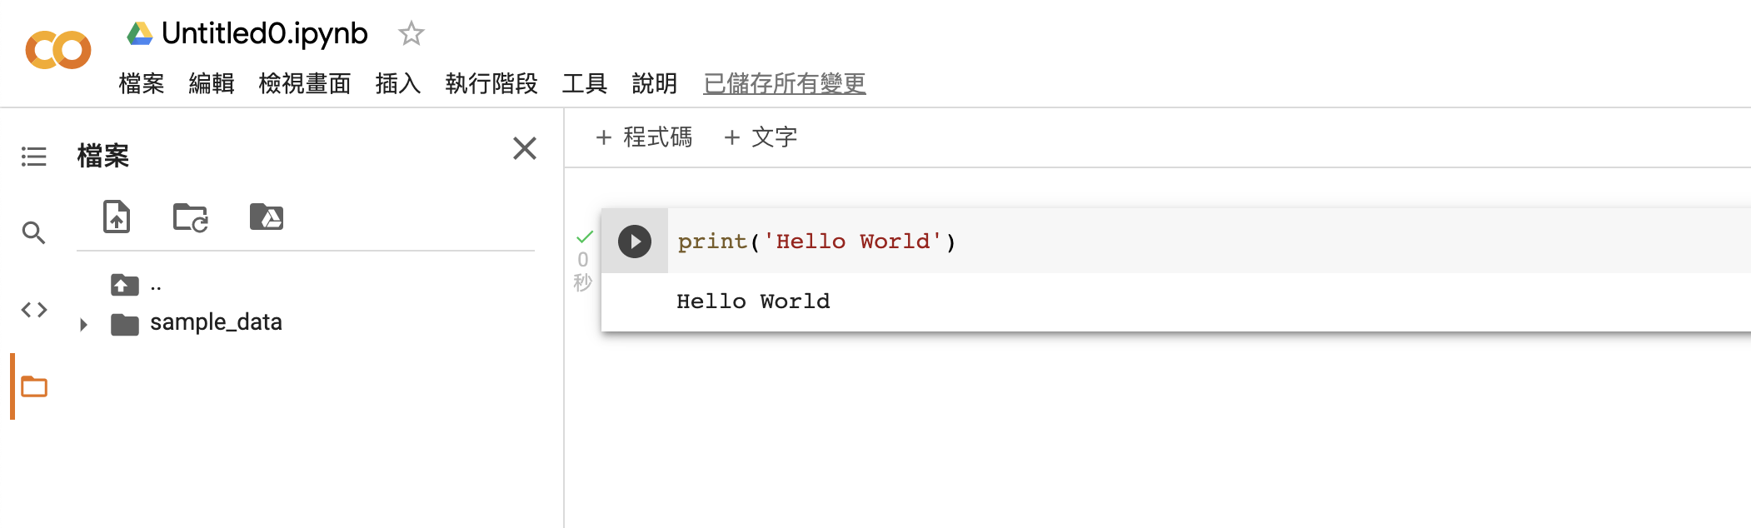
Colab User Interface (UI)
Notebook name
Python code
Code cell
Files
Output
Execute button
Notes:
This page is a description of the colab user interface.

Slide 23
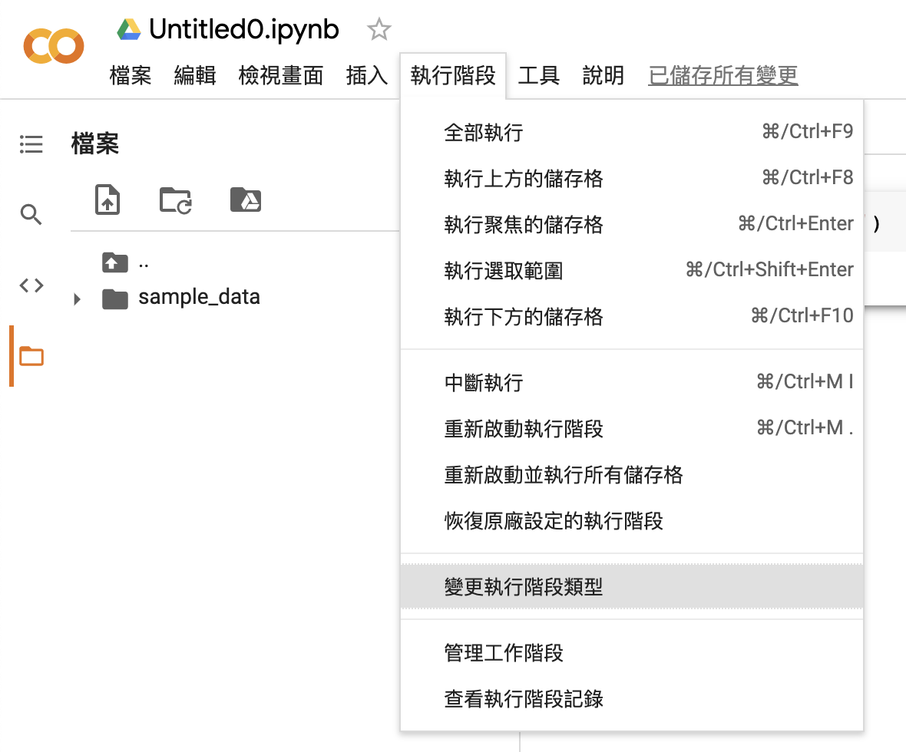
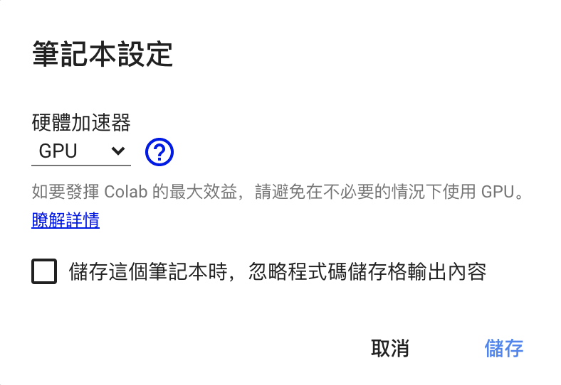
Change to Use GPU
We can change to GPU hardware accelerator.
Notes:
The steps are as the following figure.

Slide 24
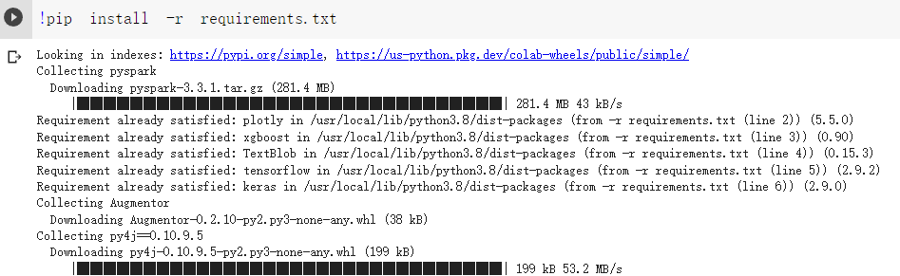
Install Pyspark on Colab
Install all the packages we need with the Python pip command.

Slide 25
Outline
Spark Introduction
Docker Introduction
Docker Installation
Spark Installation with Docker
Practice: Gender Detector with ML
Commit Docker Image
Exercise

Slide 26
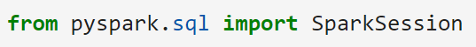
Spark Session
Spark session is a python class, which provides all the functions for processing data with spark.
We can import pyspark.sql for query data.

Slide 27
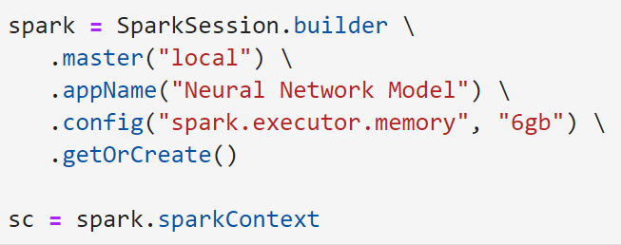
Spark Builder
Using builder to build the spark environment.

Slide 28
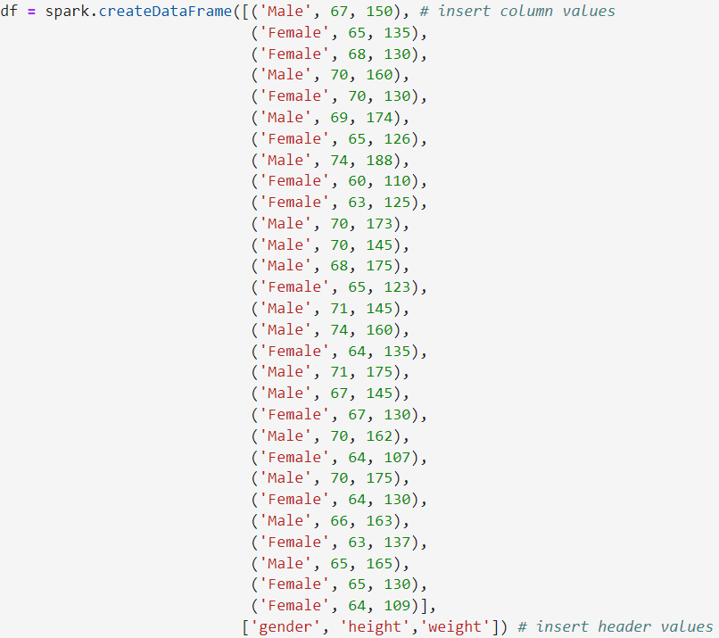
Data Frame

Slide 29
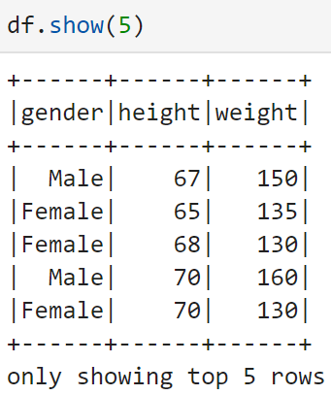
Show Data Frame
We can use show() to show the data.

Slide 30
SQL Functions
We can import functions from pyspark.sql to query data.
When() is similar to the WHERE keyword of SQL.
Select() is the same as SELECT in SQL.

Slide 31
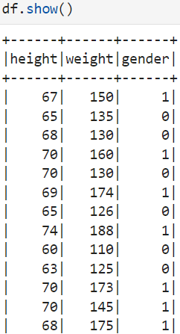
Show Data Frame
Using show() to show the data frame.

Slide 32
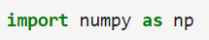
NumPy
NumPy is a basic library required for scientific operations using Python, including array operations that we will use later.
You can invoke the NumPy functions with np.
Load NumPy with import numpy as np.

Slide 33
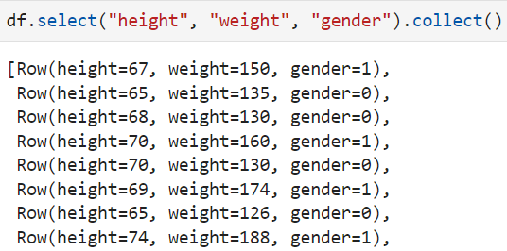
Collection
Collection is a data type in programming languages, which is used to store data.
Using collect() to transfer the data frame to a collection.

Slide 34
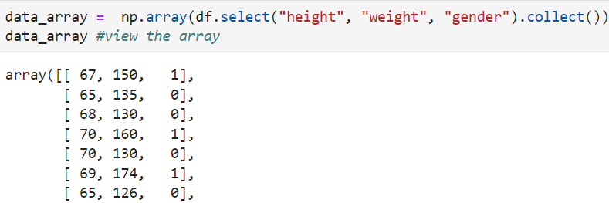
NumPy Array
NumPy array is a common data structure used to store and process data for data analytics.
Using array() to transfer the data frame to an array.

Slide 35
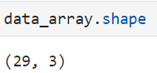
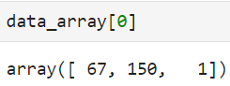
Numpy Array (Cont’d)
Using shape to print the shape of a NumPy array.
Using an index to get the data in a specified space.

Slide 36
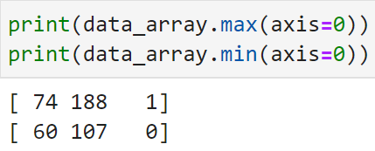
Max and Min
Using the built-in functions of NumPy can easily print maximum and minimum elements in an array.
Specify axis = 0 to find the value along axis 0.

Slide 37
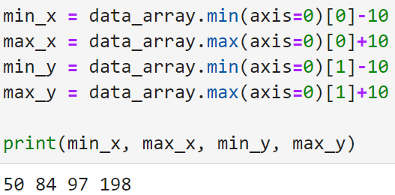
Data Visualization
First, the min and max values of both axis should be determined.

Slide 38
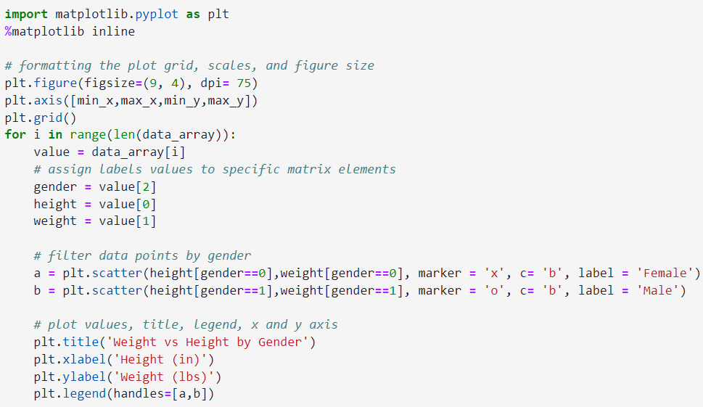
Data Visualization (Cont’d)

Slide 39
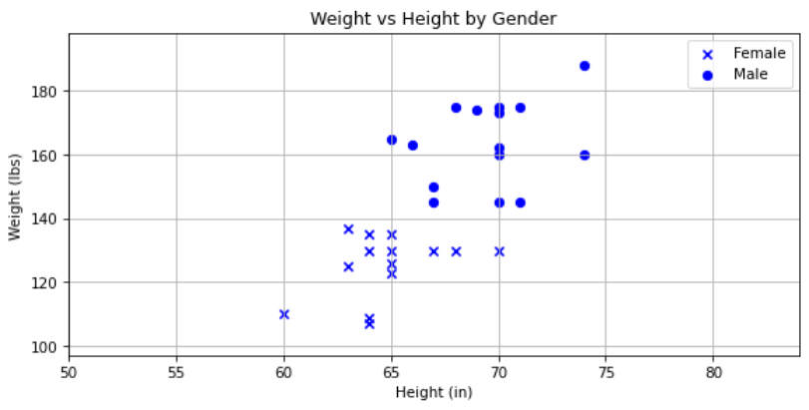
Data Visualization (Cont’d)

Slide 40
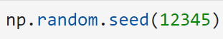
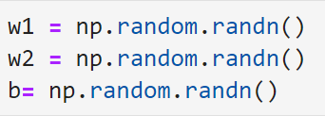
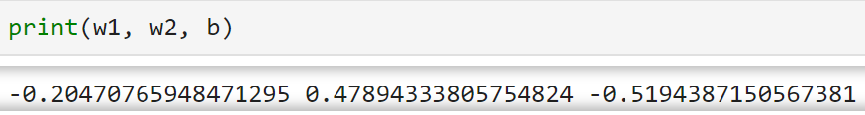
Weights and Bias Initialization
Both weights and bias can be initialized with random numbers.
After specifying the seed, the random numbers can be generated with randn().

Slide 41
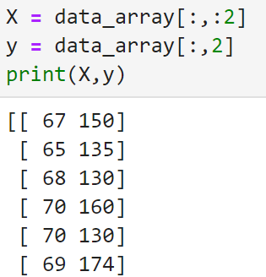
Data Slicing
The data should be split into training data and labels.
Collection slicing provided by Python can help us to achieve that.

Slide 42
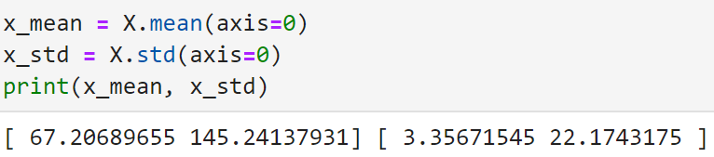
Data Normalization
Data should be normalized for better training performance.
Mean() and std() can be used to take the mean and standard deviation of a collection in Python.

Slide 43
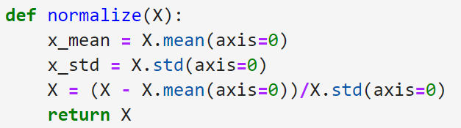
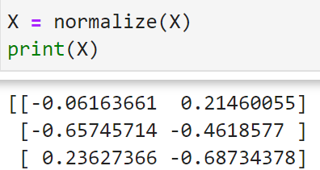
Data Normalization (Cont’d)
A function can be defined to do the normalization.

Slide 44
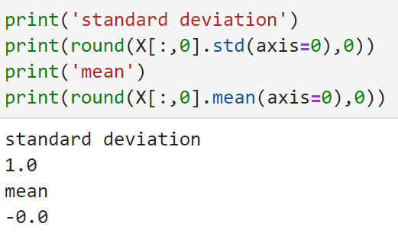
Data Normalization (Cont’d)
The normalized result can be printed.

Slide 45
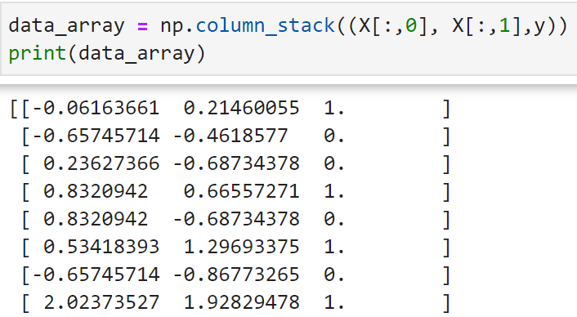
Data Normalization (Cont’d)
The normalized X and y should be combined with column_stack().

Slide 46
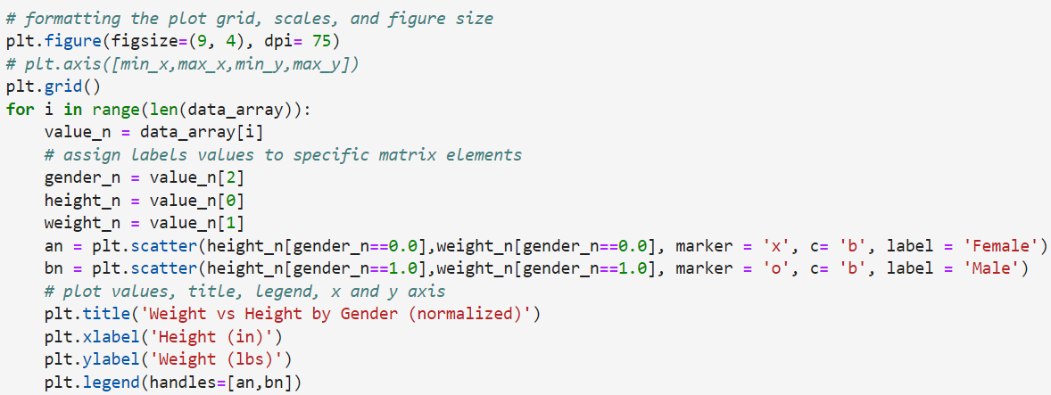
Data Visualization
Visualize the normalized data.

Slide 47
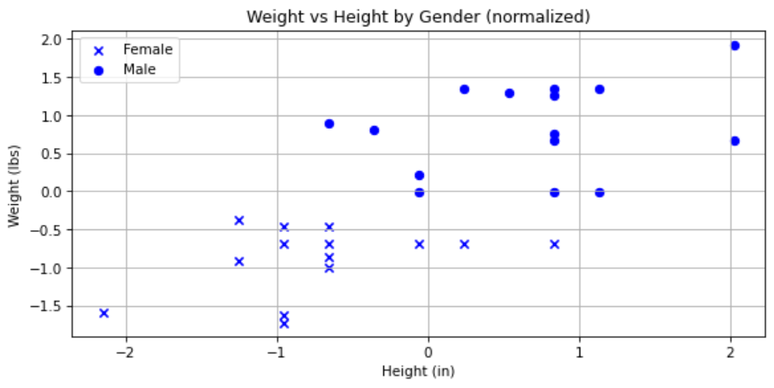
Data Visualization (Cont’d)

Slide 48
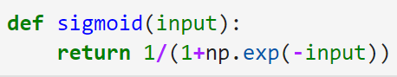
Sigmoid
Sigmoid is an algorithm for machine learning, the output will be [0..1].
The sigmoid can be implemented with exp() easily.

Slide 49
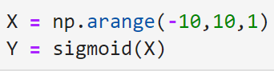
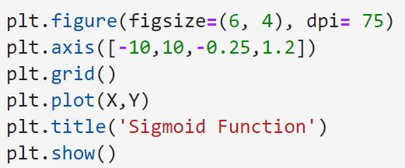
Visualize Sigmoid
Arange() is to generate a collection with evenly spaced values within a given interval.

Slide 50
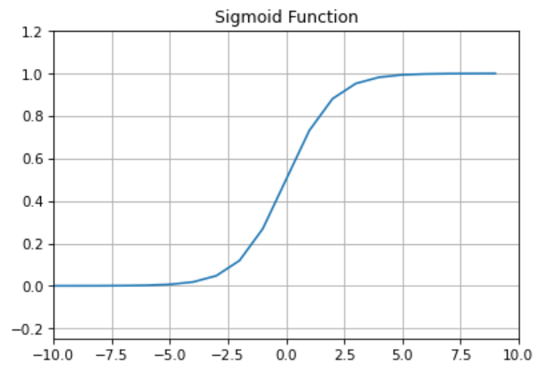
Visualize Sigmoid (Cont’d)

Slide 51
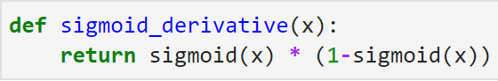
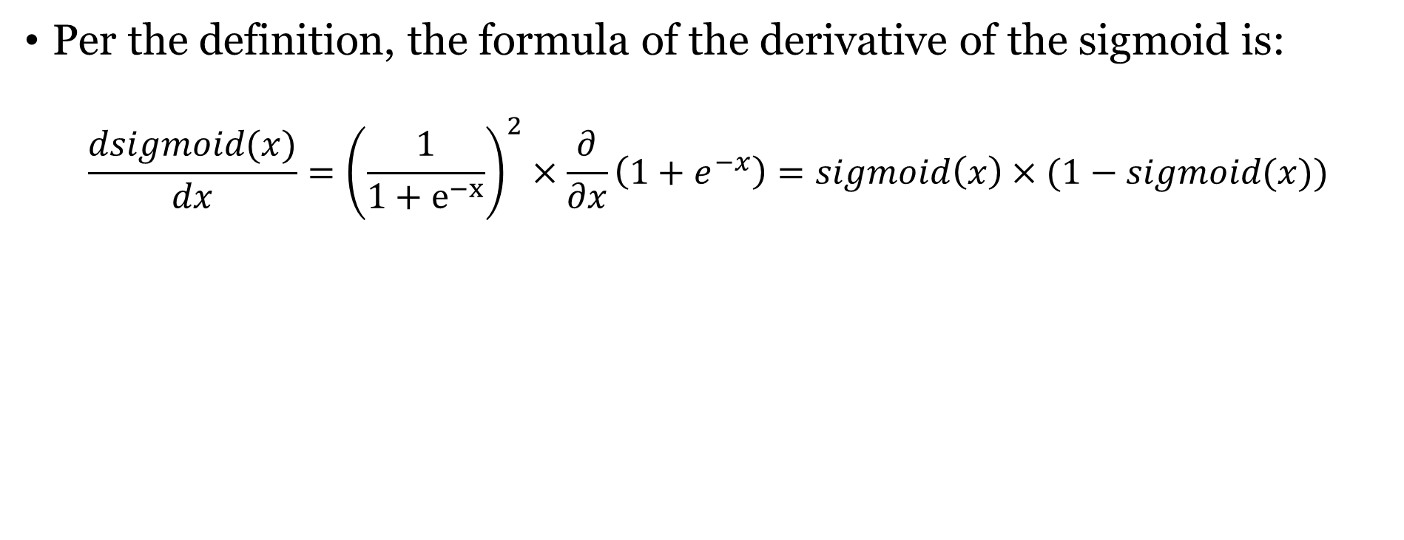
Derivate of Sigmoid
Per the definition, the formula of the derivative of the sigmoid is:
$$\frac{dsigmoid(x)}{dx}={\left(\frac{1}{1+e^{−x}}\right)}^{2}×\frac{∂}{∂x}\left(1+e^{−x}\right)=sigmoid\left(x\right)×(1−sigmoid(x))$$

Slide 52
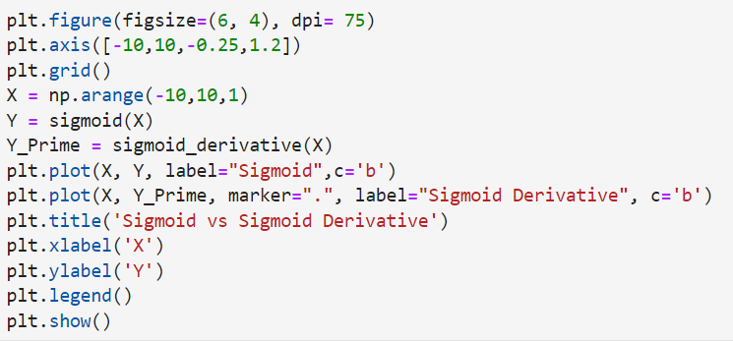
Visualization

Slide 53

Visualization (Cont’d)

Slide 54


Randomize the data
Before we start training, we should extend and randomize the data.

Slide 55

Training
The learning_rate will be set to 0.1.
The all_costs[] is initialized.

Slide 56

Training (Cont’d)
A random person will be taken to calculate.

Slide 57

Training (Cont’d)
Calculate the result, then compare it with the actual gender as the cost value.

Slide 58

Training (Cont’d)
Both weights and biases should be adjusted with the result.

Slide 59

Training (Cont’d)

Slide 60

Visualize the Result

Slide 61

Print Weights and Bias

Slide 62

Check the Result

Slide 63

Define the Normalize Function

Slide 64

Define the Predict Function

Slide 65


Evaluate the Model
The height and weight can be determined to evaluate the trained model.

Slide 66


Evaluate the Model (Cont’d)

Slide 67

Visualize the Result
Determine the min and max values of both axes.

Slide 68
Visualize the Result (Cont’d)
Using arange() to generate the collections.

Slide 69
Visualize the Result (Cont’d)
The data can be combined with for loop.

Slide 70

Visualize the Result (Cont’d)

Slide 71

Visualize the Result (Cont’d)

Slide 72
Outline
Spark Introduction
Docker Introduction
Docker Installation
Spark Installation with Docker
Practice: Gender Detector with ML
Commit Docker Image
Exercise

Slide 73

Sign-in to Docker Hub
Click the sign-in button on the docker desktop.

Slide 74

Sign-in to Docker Hub (Cont’d)
Sign-in or Sign-up to the Docker Hub.

Slide 75

Sign-in to Docker Hub (Cont’d)
Click the proceed button after signed-in.

Slide 76

Sign-in to Docker Hub (Cont’d)
After signed-in, the user name will be shown on the docker desktop.

Slide 77

Create Repository
Open Docker Hub and Click the Create repository button.

Slide 78

Create Repository (Cont’d)
Input the name and description of the repository, then click the Create button.

Slide 79

Create Image Tag
Using docker tag command to create a new docker image tag on the terminal.
Please note that the new_image name should be the same as the repository you created.
The format is:

Slide 80

Create Image Tag (Cont’d)
After tagging, a new image should be shown on your docker desktop interface.

Slide 81
Check the Container ID
Using docker ps –all to list all the containers on terminal.

Slide 82

Commit Container
Using the commit command to commit the local change to the specified docker image.
A hashed value will be shown after committing.
Format:

Slide 83

Push to Docker Hub
Using push to push the docker image to a specified repository.
Format:

Slide 84

Push to Docker Hub (Cont’d)

Slide 85

Push to Docker Hub (Cont’d)
The docker image will be shown on the docker hub after pushing.

Slide 86
Outline
Spark Introduction
Docker Introduction
Docker Installation
Spark Installation with Docker
Practice: Gender Detector with ML
Commit Docker Image
Exercise

Slide 87
Exercise
That is a little bit inaccurate to determine the gender of a person with only height and weight.
Please add a factor which is the body fat percentage of a person and re-train your model.
That will be fascinating if you want to add other factors to make the model better.
Please gather the data on body fat percentage and other factors from the internet to create reliable results.

Slide 88
Extra Bonus
After introducing Docker, can you describe the differences between Docker containers and virtual machines (VMs)? And what situations are using Docker containers better than VMs and what are not?

Slide 89
Send Your Works
Please upload the works you have done to the docker hub with a repository named username/studentID_emba_spark.
Please send the repository name and the answers to the mail: t110368151@ntut.org.tw
The deadline for this exercise is 12/27/2022.

